Slide 1
PHISHING AWARENESS TRAINING
STAY SAFE. STAY INFORMED. STAY PROTECTED.
MWESIGA IVAN JEROME : CodeALPHA : 3RD JUNE, 2025.

Slide 2
INTRODUCTION TO PHISHING
Definition : Phishing is a cyberattack that uses disguised emails, messages, or websites to trick users into revealing sensitive information.
Goal: Understand, recognize, and avoid phishing attacks.

Slide 3
WHY PHISHING MATTERS 🐟🐠🎣
Statistics :
90% of data breaches start with phishing.
Over $10 billion in losses annually (as of recent data).
Common targets: Employees, students, executives—anyone with access to valuable data.

Slide 4
TYPES OF PHISHING ATTACKS
1. Email Phishing – Fake messages that look real.
2. Spear Phishing – Targeted emails personalized for a specific person.
3. Whaling – Targeting executives or high-profile individuals.
4. Smishng – Phishing via SMS or messaging apps.
5. Vishing – Voice phishing over the phone.
6. Pharming – Redirecting users to fake websites.

Slide 5
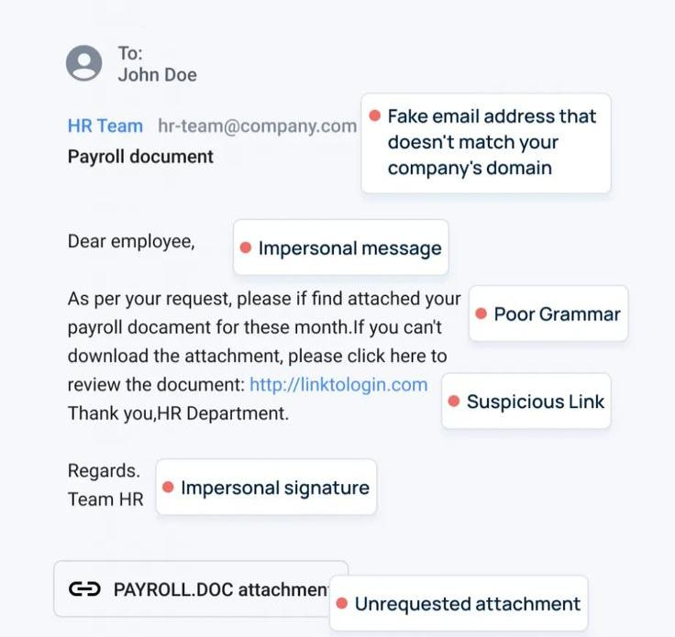
Anatomy of a phishing email
Highlighted parts:
Suspicious sender address Poor Grammar Unexpected attachments or links Generic greeting (“Dear Employee”)
2. Example E-mail Screenshot showing fake email.

Slide 6
SOCIAL ENGINEERING TACTICS
Impersonation (Boss, IT Support)
Urgency and fear (“immediate action required”)
Curiosity (“You’ve won a prize!”)
Trust exploitation (Spoofing brands/logos)

Slide 7
Real world examples
Case Study 2 : CEO Fraud
Case Study 2 : COVID 19 scam email
Brief impact explanation : Data loss, financial loss, and reputational damages.

Slide 8
How to protect yourself.
Think before you click. : Hover over links
Verify Requests : Contact the sender directly
Never share passwords via email or texts.
Report Suspicious Emails to IT/Security

Slide 9
What to do if you fall victim.
IMMEDIATE STEPS :
Disconnect from the network
Report to IT/ Security team
Change Compromised passwords
Monitor accounts for suspicious activity

Slide 10
Summary and key takeawayS.
Be skeptical of unexpected communication
Double check links and sender addresses
Stay educated, stay alert
Report all suspicious activities

Slide 11
RESOURCEs and further reading.
StaySafeOnline.org
PhishTank
Company IT policies/ Contact information

Slide 12
Organizational responsibilities.
Regular Employee Training
Spam filters and email protection tools
Multi-factor authentication (MFA)
Incident response plans

